Slide 1
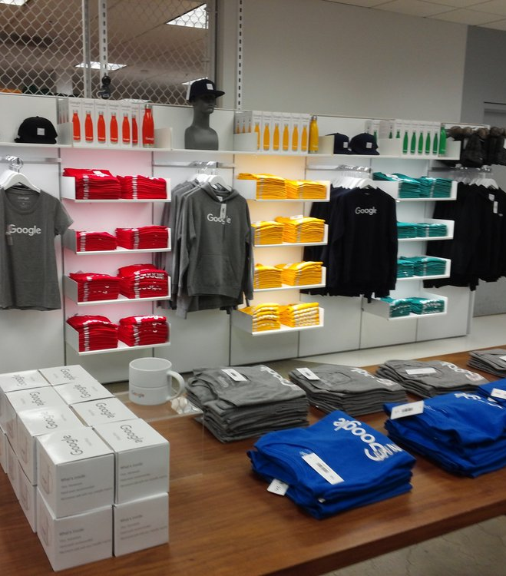
Flatiron Capstone Project Google Analytics Customer Revenue Prediction
Thomas O’Gara

Slide 2

Objectives
Predict the revenue of each visit to the Google Merchandise Store
What variables drive revenue?
Make a recommendation to the store owner to predict revenue using as little resources as possible

Slide 3
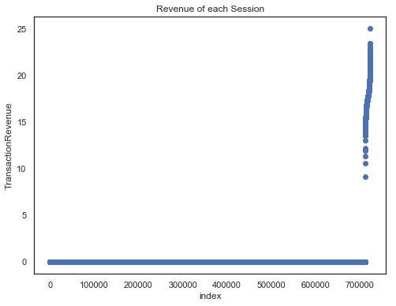
1.274% of Store Visits resulted in Revenue

Slide 4
Features
fullVisitorId- A unique identifier for each user of the Google Merchandise Store.
channelGrouping - The channel via which the user came to the Store.
date - The date on which the user visited the Store.
device - The specifications for the device used to access the Store.
geoNetwork - This section contains information about the geography of the user.
socialEngagementType - Engagement type, either "Socially Engaged" or "Not Socially Engaged".
totals - This section contains aggregate values across the session.
trafficSource - This section contains information about the Traffic Source from which the session originated.
visitId - An identifier for this session. This is part of the value usually stored as the _utmb cookie. This is only unique to the user. For a completely unique ID, you should use a combination of fullVisitorId and visitId.
visitNumber - The session number for this user. If this is the first session, then this is set to 1.
visitStartTime - The timestamp (expressed as POSIX time).
hits - This row and nested fields are populated for any and all types of hits. Provides a record of all page visits.
customDimensions - This section contains any user-level or session-level custom dimensions that are set for a session. This is a repeated field and has an entry for each dimension that is set.

Slide 5
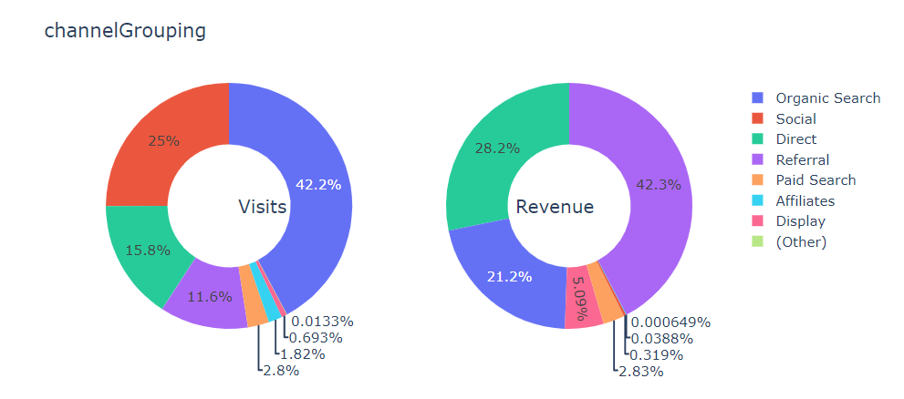

Slide 6
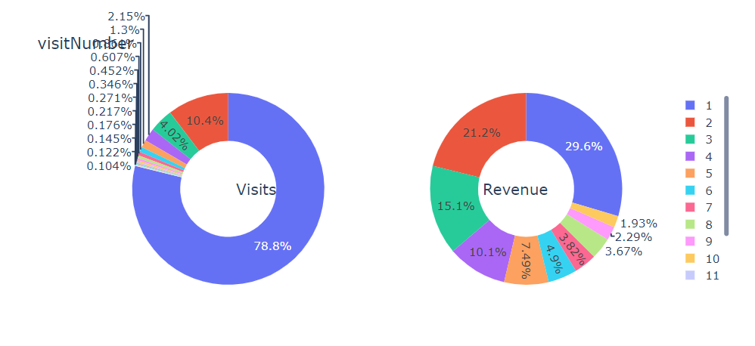

Slide 7
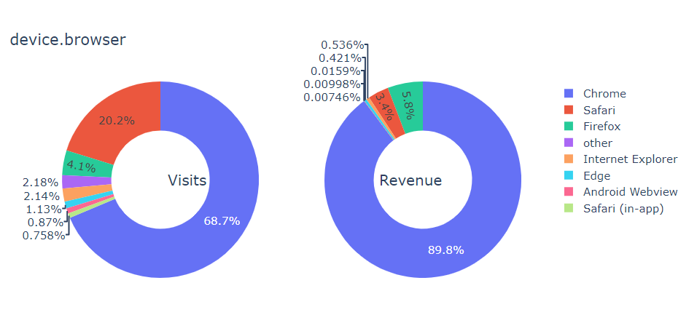

Slide 8
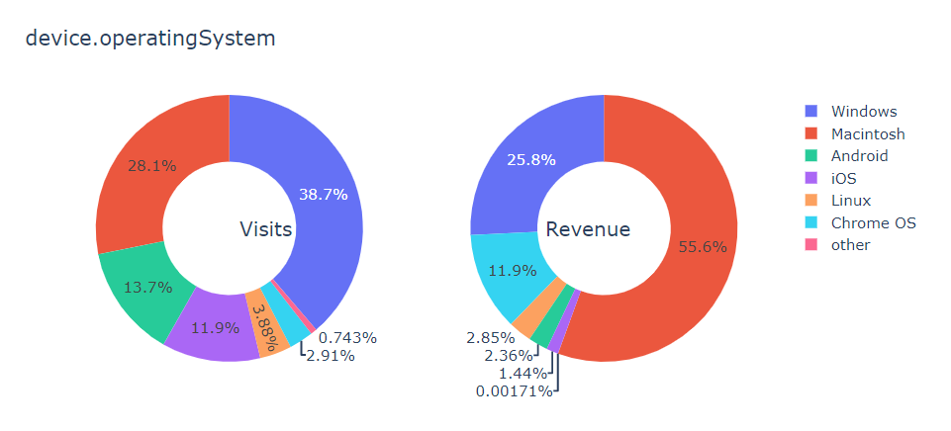

Slide 9
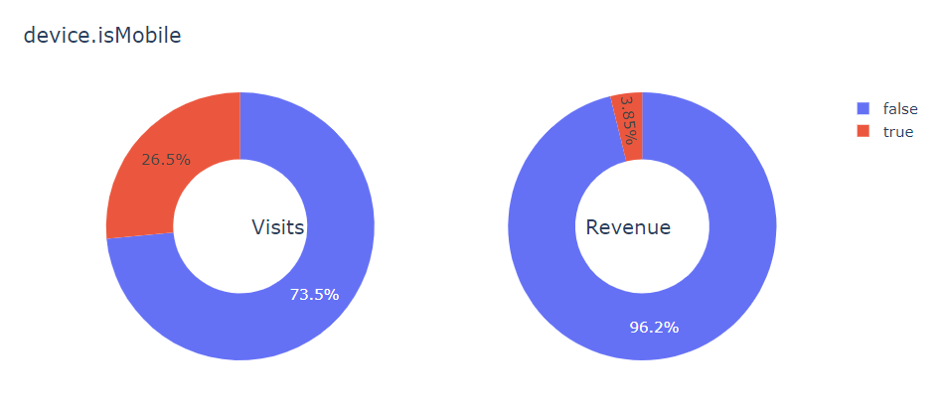

Slide 10
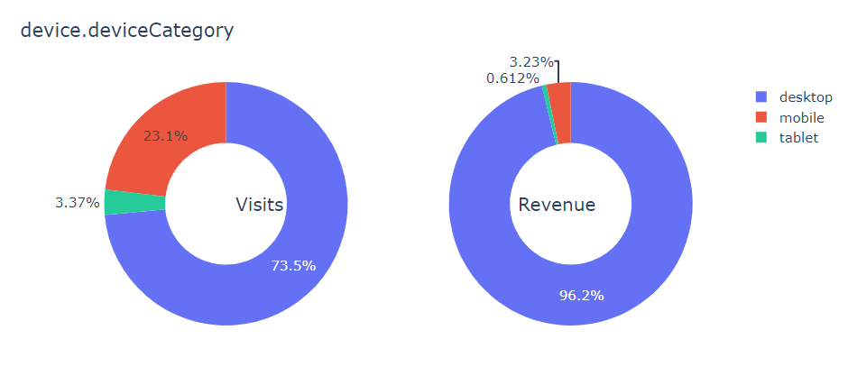

Slide 11
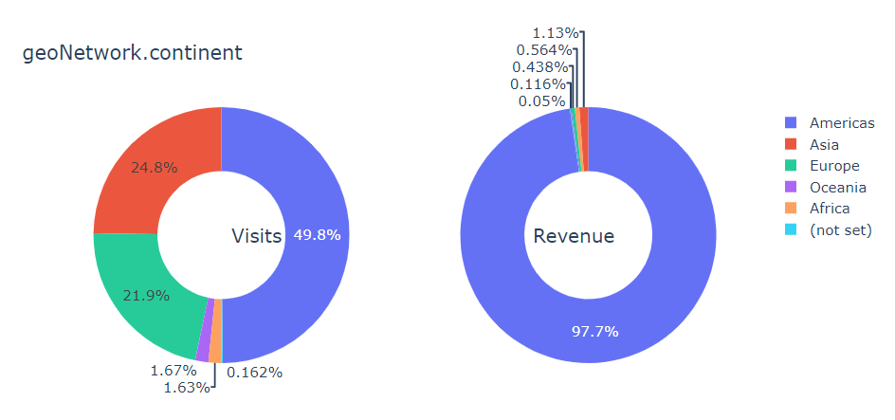

Slide 12
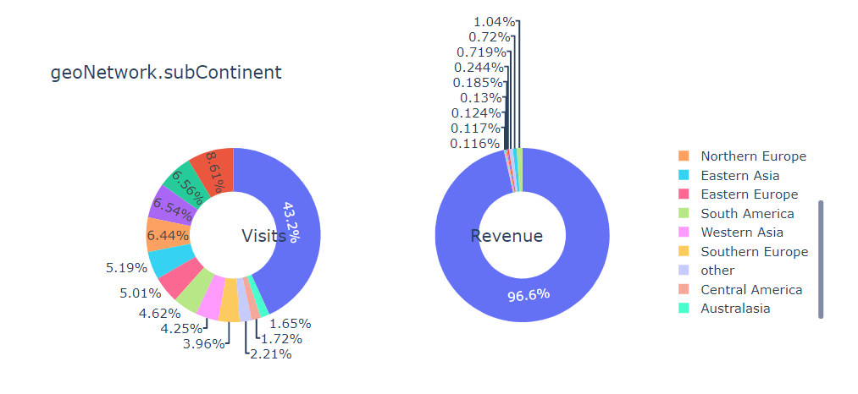

Slide 13
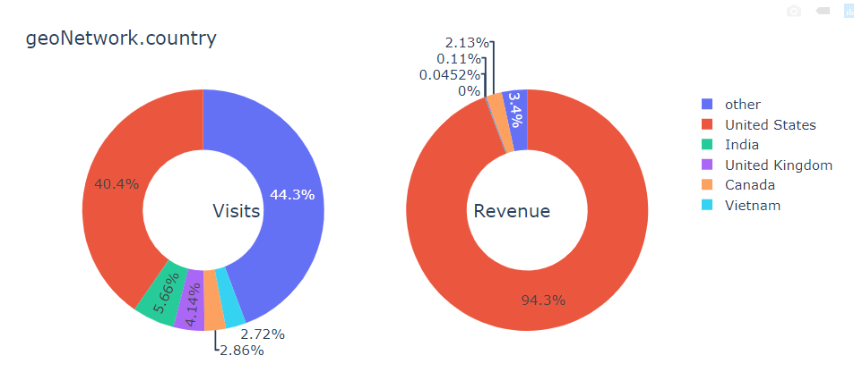

Slide 14
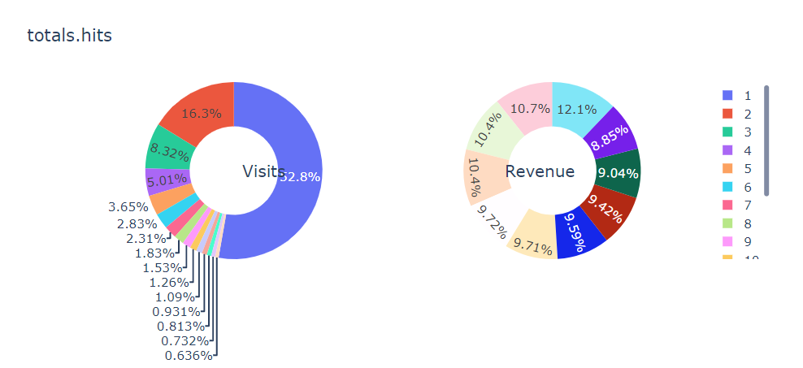

Slide 15
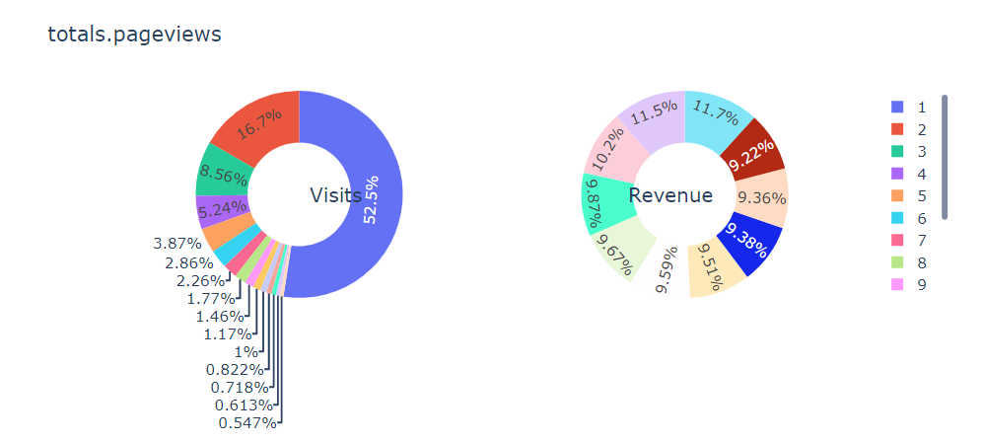

Slide 16
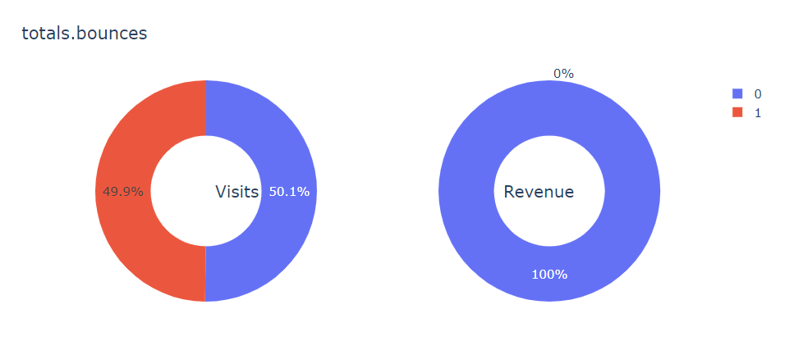

Slide 17
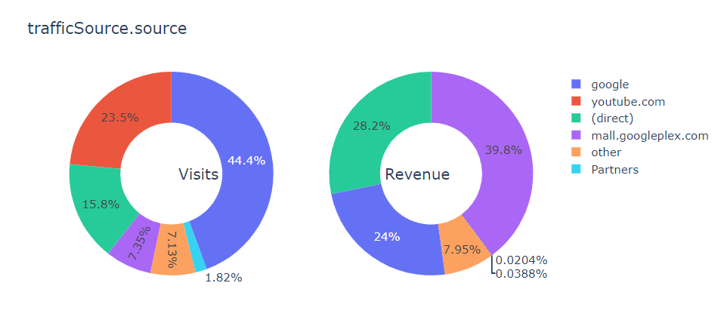

Slide 18
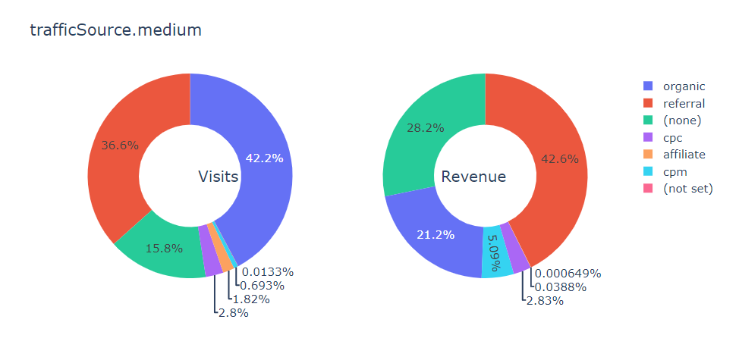

Slide 19
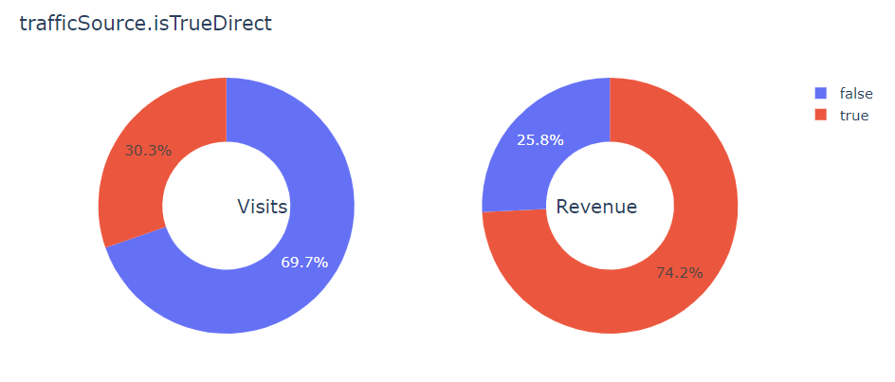

Slide 20
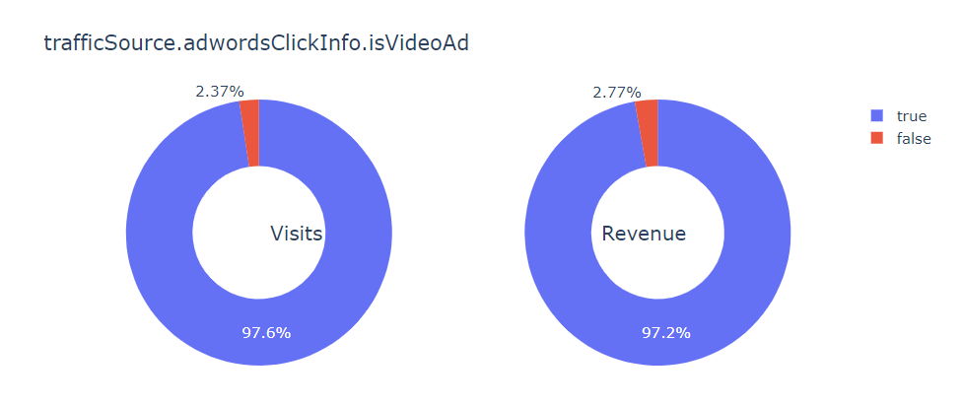

Slide 21
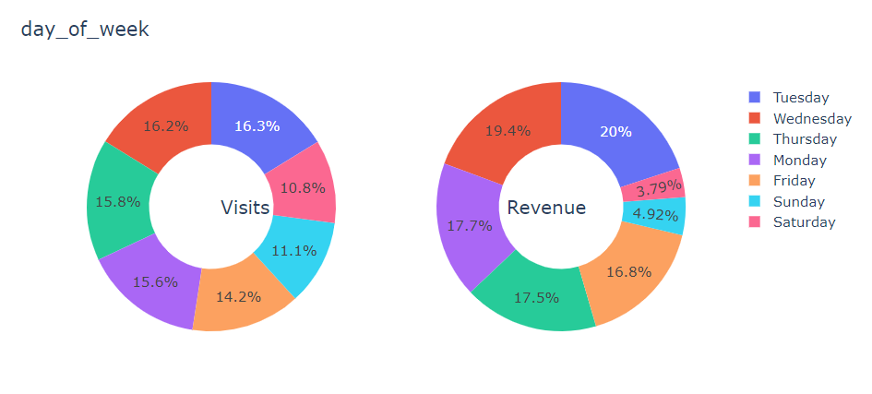

Slide 22
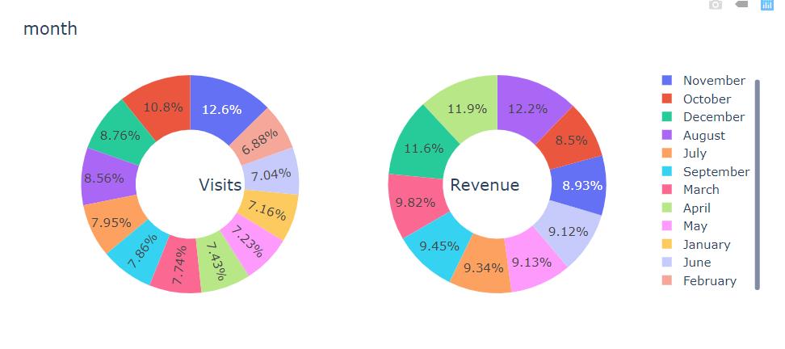

Slide 23

Model
Random Forest Regressor

Slide 24
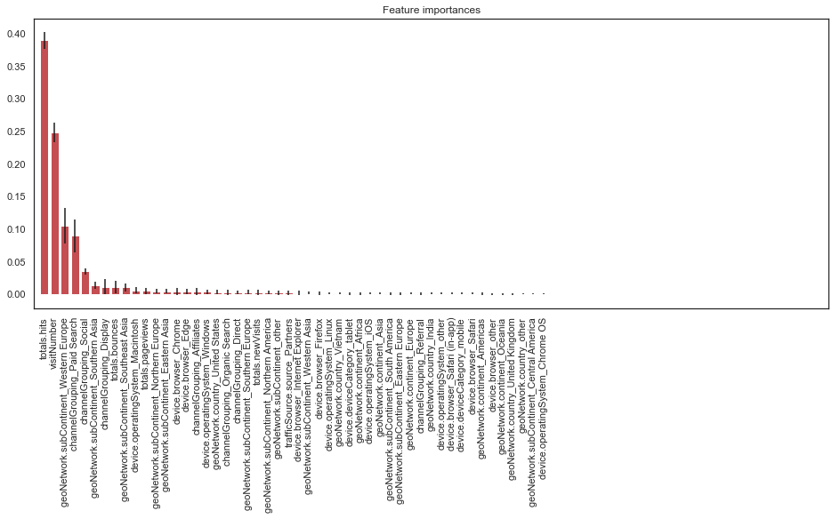

Slide 25
Top 5 features
Explains over 76% of the variance of this model
Accuracy is only about 8% worse when modeling with these 5 features

Slide 26
Recommendation
Only 25% of the variance in the revenue is predictable from the independent variables
Model using only 5 features is 8% less accurate – recommend using this to lower costs
Try another model such as XGBoost or another gradient boosting algorithm – could be quite a bit more accurate
Need cloud computing services such as AWS – each model took 2 hours+ to run

Slide 27
Questions?

